Slide 1
Amazon Movies & TV Reviews Database Analysis
Ho Man Leung, Drazen Zack & Arthur Bertrand

Slide 2
Analyzing reviews using Natural Language Processing (NLP)
Exploratory Data Analysis (EDA)
Data Processing
Implementing Algorithms
Validation
Testing your Model

Slide 3
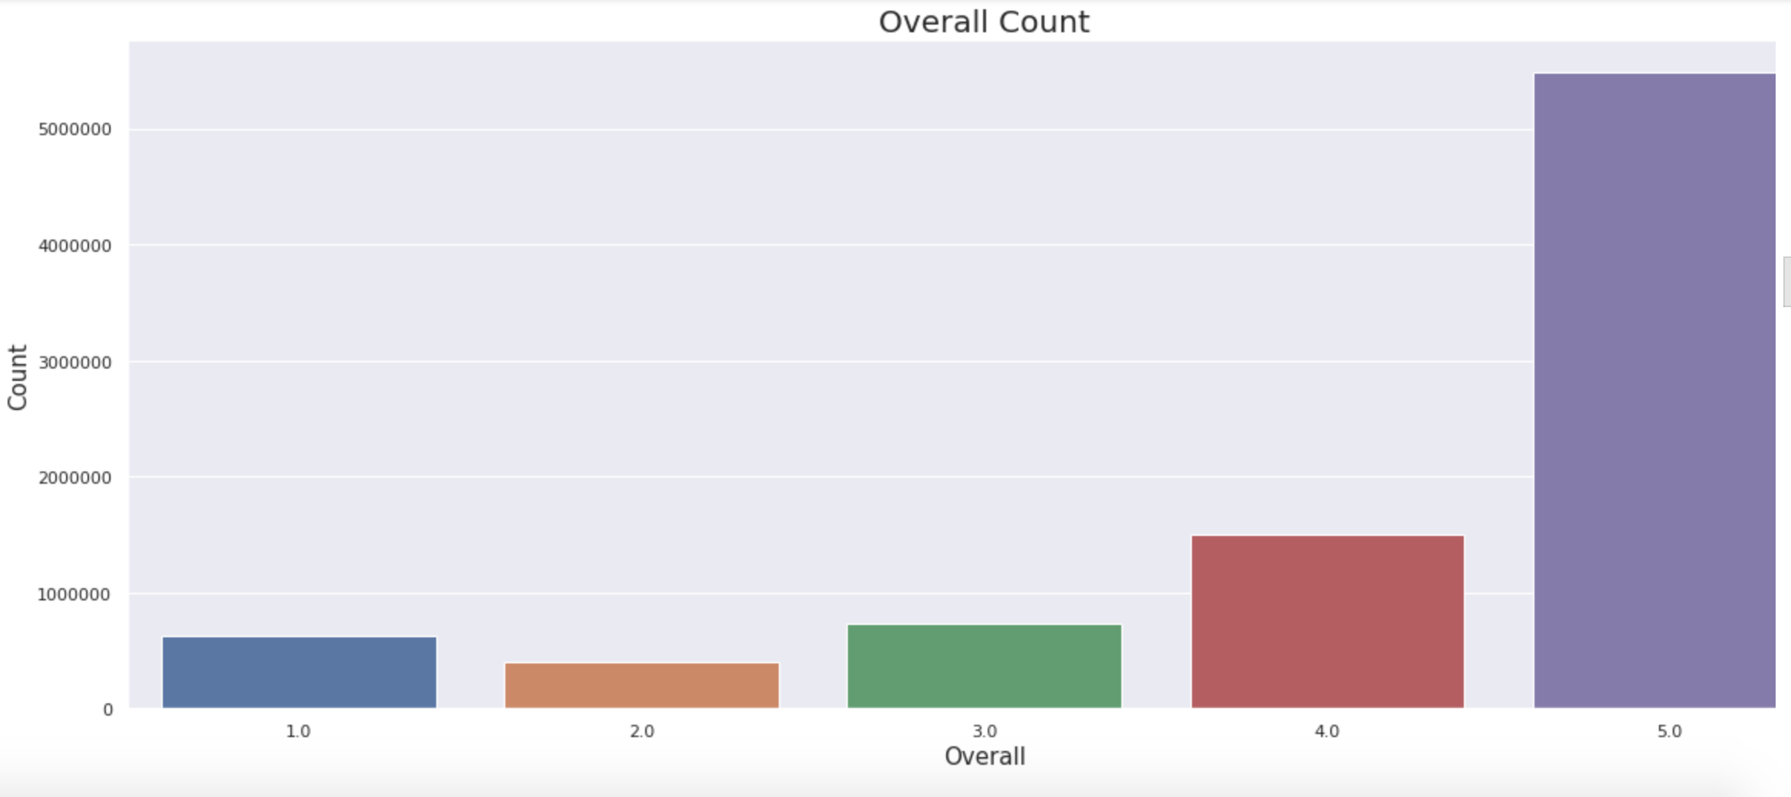
Exploratory Data Analysis (EDA)
Overall Representation of the Data

Slide 4
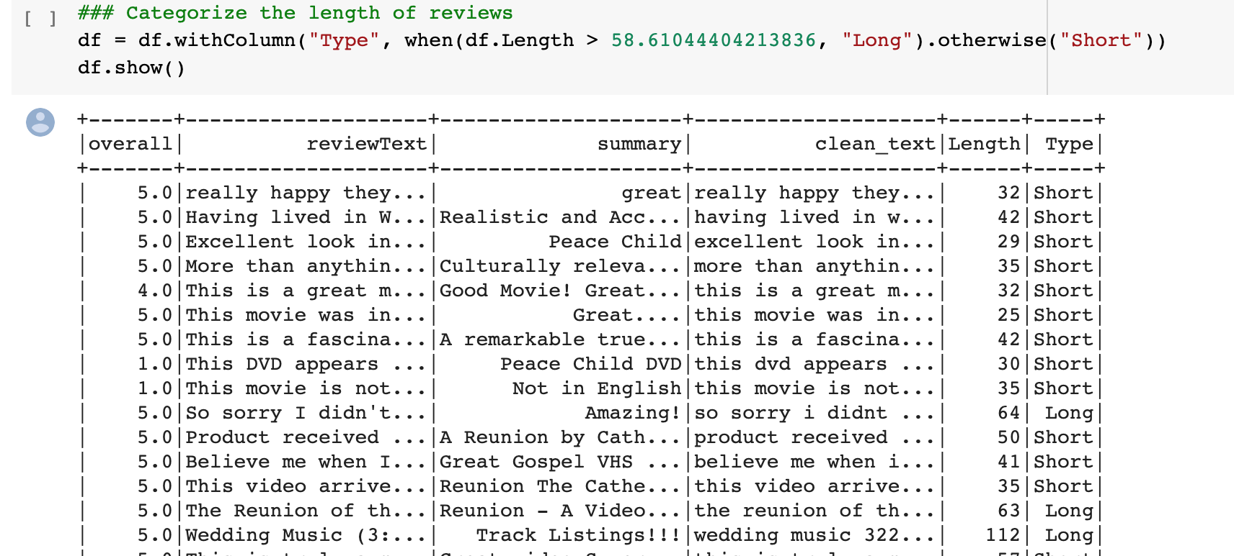
B. Categorize the Length of the Data

Slide 5
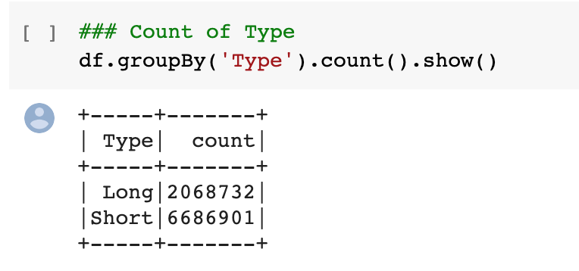
B. Length of the Data -- Results

Slide 6
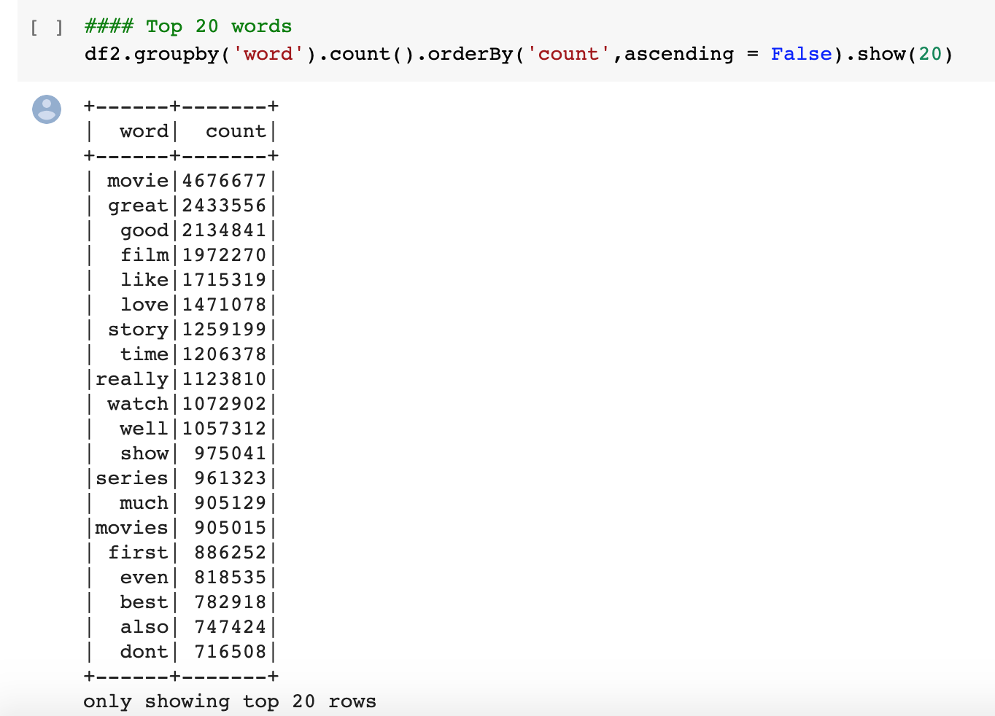
C. Most Common Words in the Data Set

Slide 7
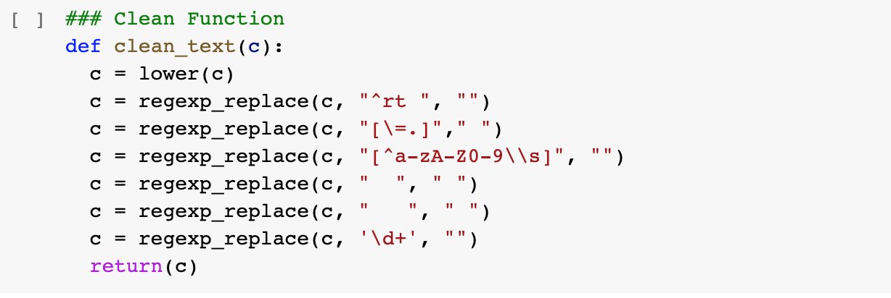
2. Data Processing
A & B. Remove Punctuations & Special Characters & Lowercase

Slide 8
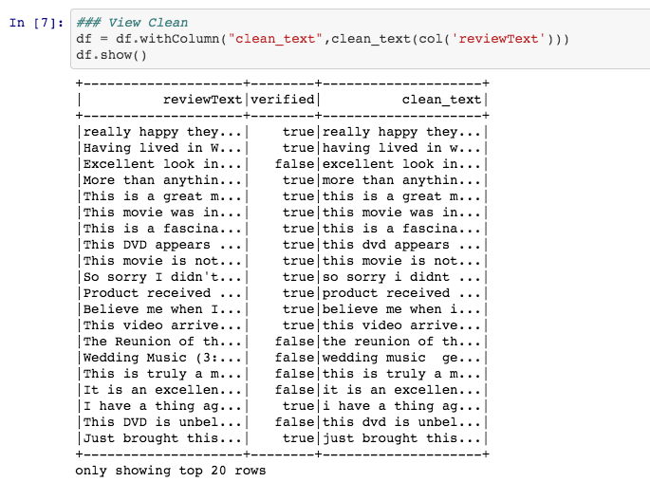
A & B. Results

Slide 9
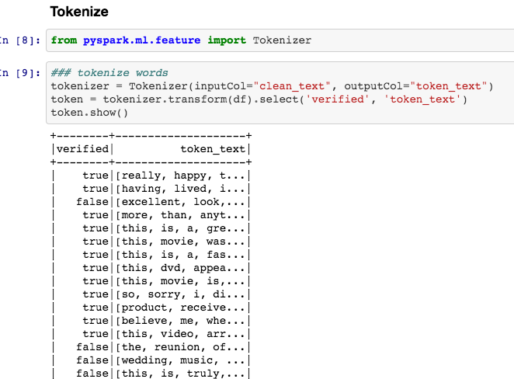
C. Tokenizer & Remove Stop Words

Slide 10
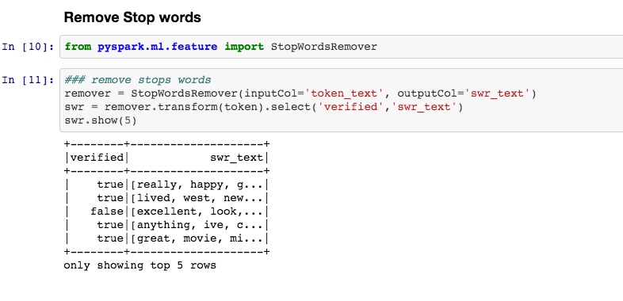
C. Tokenizer & Remove Stop Words (part 2)

Slide 11
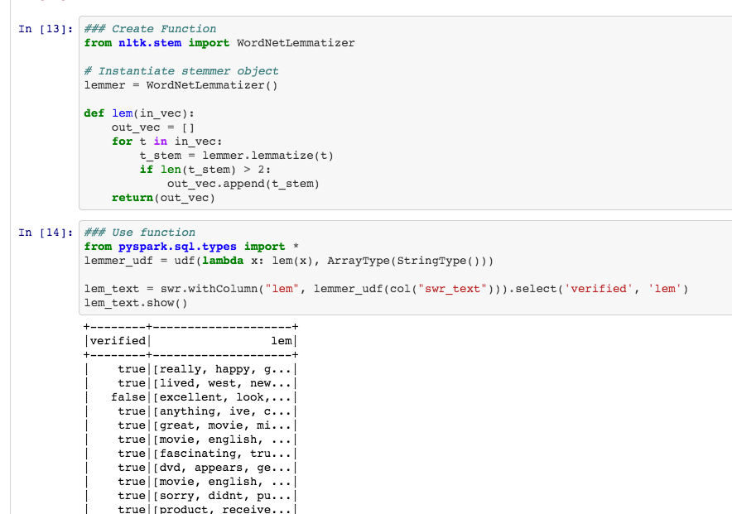
D. Lemmatization

Slide 12
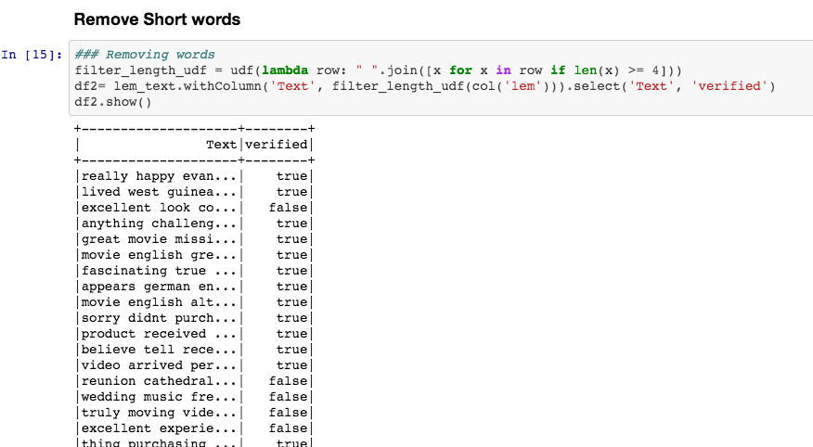
E. Removing Short Words

Slide 13
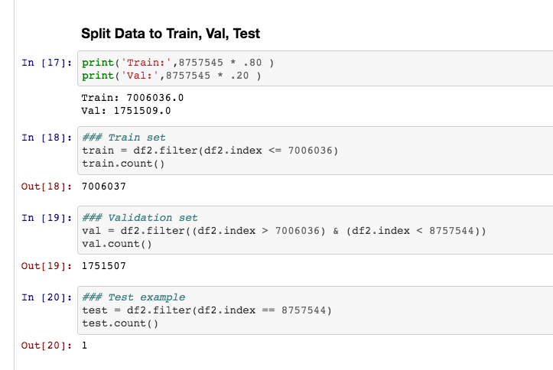
F. Split data into Train, Validation, Test

Slide 14
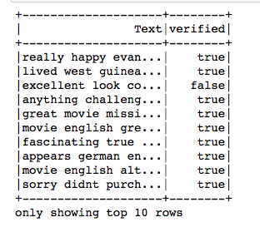
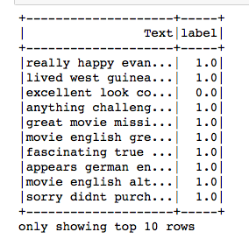
3. Machine Learning
A . Create a Label Column

Slide 15
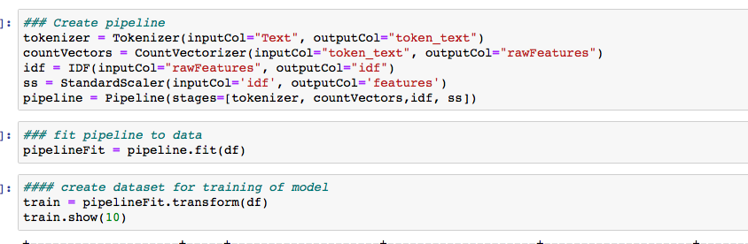
B. Create a Pipeline

Slide 16

C. Create & Fit a Logistic Regression Model

Slide 17
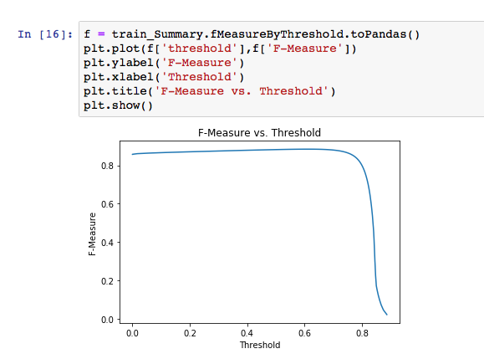
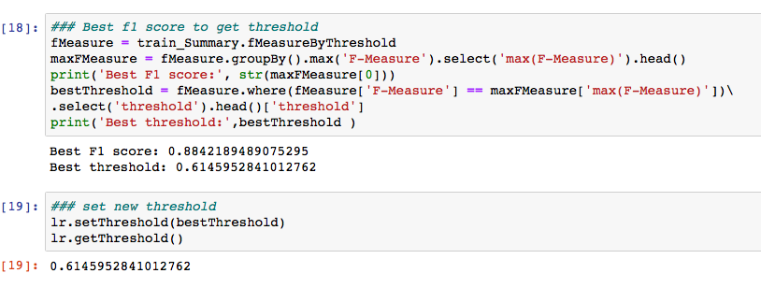
C. Change Threshold
3:1 True to False
Threshold starts out at 0.5
New Threshold is 0.615 for positive class (1)

Slide 18
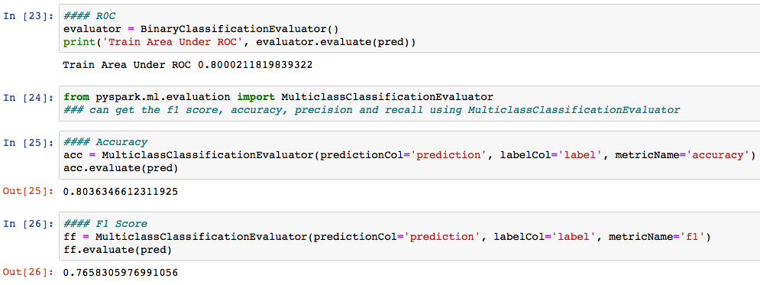
D. Evaluate Model on Train Data
Roc : 0.80
Accuracy: .804
F1 score: 0.7658

Slide 19
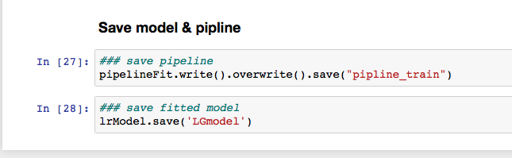
E. Save Model and Pipeline

Slide 20
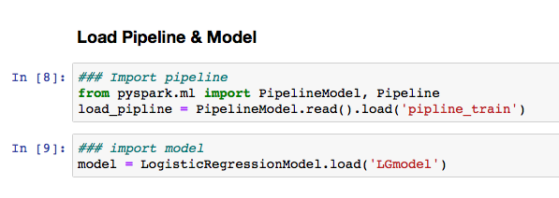
4. Validation
A. Load Model and Pipeline

Slide 21
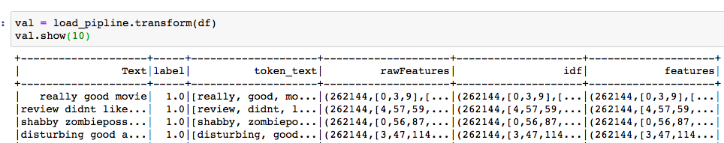
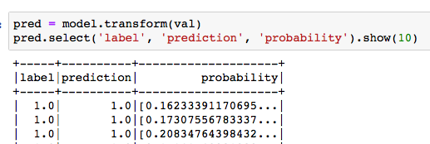
B. Transform data and predict

Slide 22
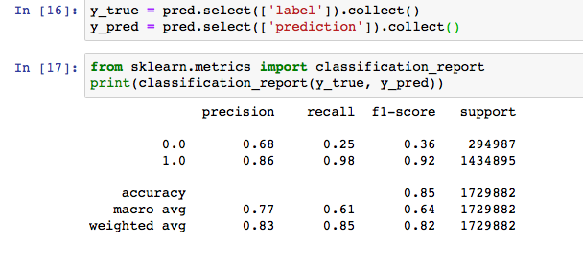
C. Evaluate Model on Validation Data
Roc : 0.80
Accuracy: .852
F1 score: 0.822

Slide 23
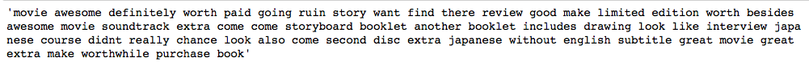
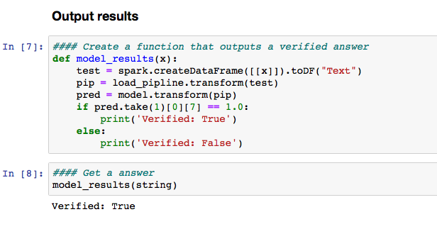
5. Testing
Output a Result

